Slide 1
SOC 101: Introduction to Sociology
Lecture1: Definition and scope of Sociology
Dr. Bulbul Ashraf Siddiqi
Associate Professor
Dept. of Political Science and Sociology

Slide 2
What is Sociology?
Scientific study of social behaviour and human groups.
It focuses on social relationship and how it impacts/ influences on people’s behaviour
It examines the underlying pattern of human behaviour and social relationship
the process of development of society (the sum of these relationships)

Slide 3
What does it mean to be scientific?
Science refers to the body of knowledge obtained by methods based on systematic observation.
Social science is the study of the social features of humans and the ways in which they interact and change following
Organised, systematic study of phenomena (i.e., human behaviour)
Of course there is a great difference
Social sciences: Sociology, Anthropology, economics, history, psychology, political science.
Human society is the living laboratory for social science.

Slide 4
Culture and Society
What is Culture?
Culture is the totality of learned, socially transmitted customs, knowledge, material objects, and behaviour. It includes the ideas, values, and artifacts (for example, DVDs, comic books, and birth control devices) of groups of people.
Tylor defined culture as the “complex whole which includes knowledge, belief, art, law, morals, custom, and any other capabilities acquired [learned] by man as a member of society” (1920:1)
Culture is an historical process, with any culture composite and hybrid and showing variations with groups.
Language is the critical element of culture that sets humans apart from other species.

Slide 5
Culture and Society
What is society?
A society is the largest form of human group. It consists of people who share a common heritage and culture. Members of the society learn this culture and transmit it from one generation to the next. They even preserve their distinctive culture through literature, art, video recordings, and other means of expression.
Members of society generally share a common language, which facilitates day-to-day exchanges with others.

Slide 6
Scope of Sociology
Study various institutions of society
Applied sociology:
To bring positive changes
Generate Knowledge to understand the society and its impact on member of society:
It studies the influence of society on people’s attitudes and behaviour
Process of interaction and how it shapes society
Human behaviour:
why does the attitude and behaviour is culture and society specific in many cases?

Slide 7
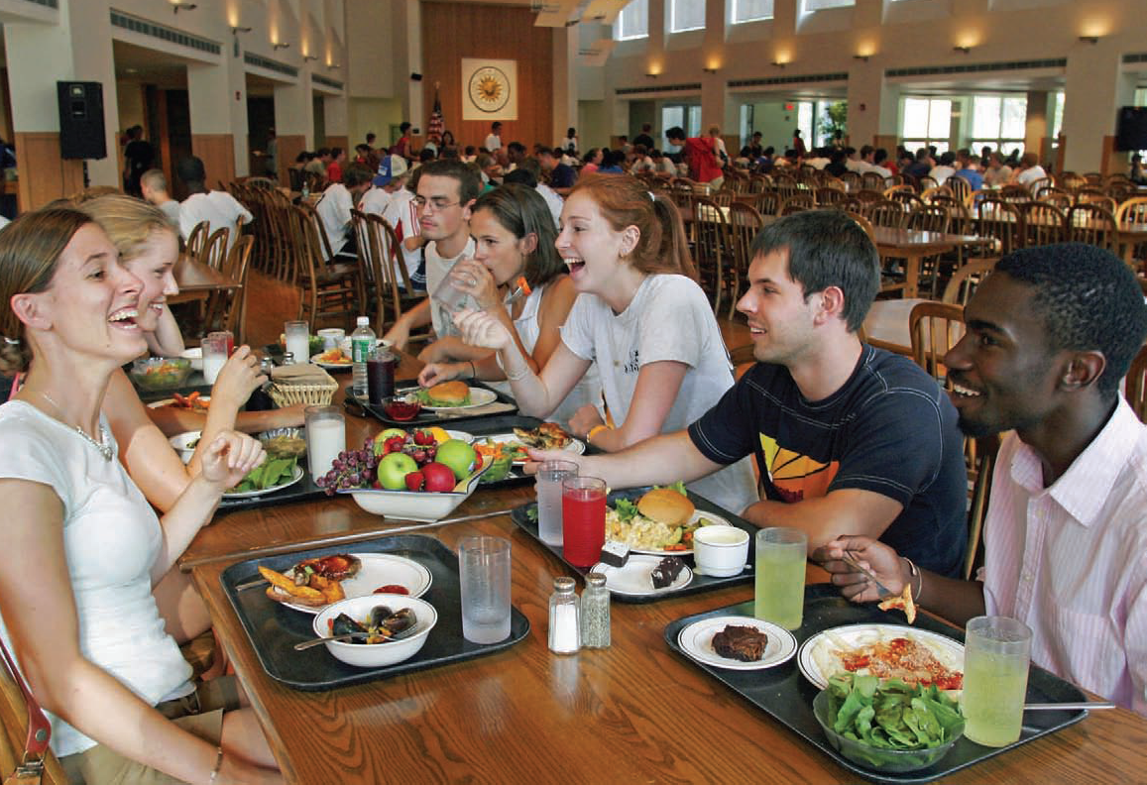
Images

Slide 8
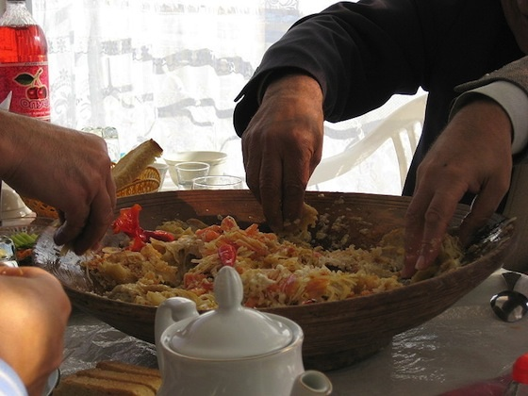

Slide 9
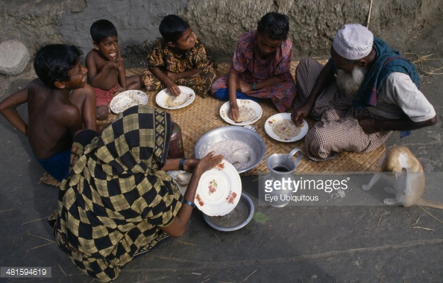

Slide 10
Approach
Sociological Imagination
Critical thinking: Charles Wright Mills described such thinking as sociological imagination
This is an awareness of the relationship between an individual and the wider society.
Seeing ones own society as an outsider.
See the world and its people in a new way and through a broader lens.
The issue of Divorce
Clean UP Dhaka

Slide 11
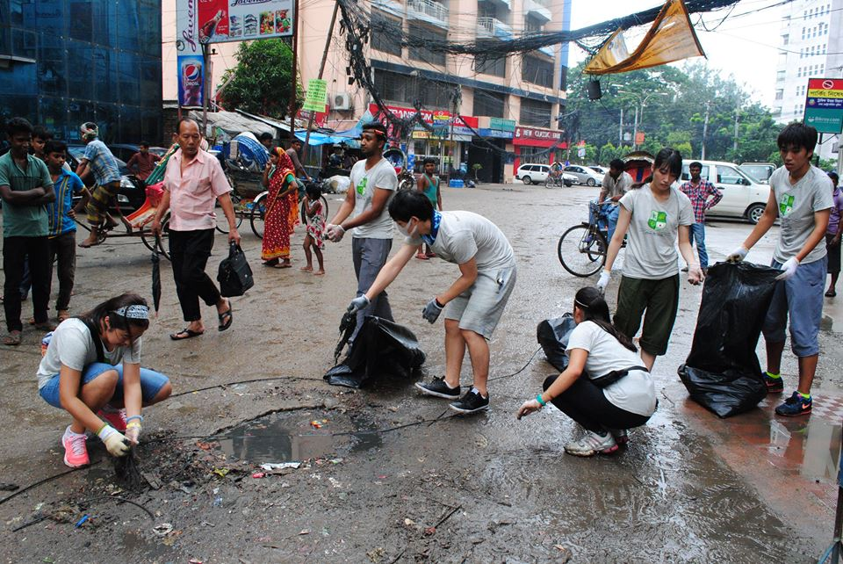
Clean Up Dhaka

Slide 12
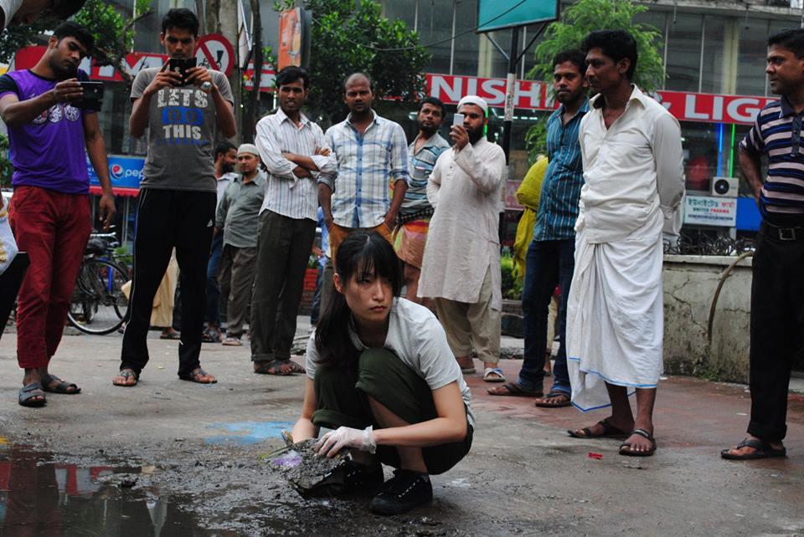
Clean Up Dhaka

Slide 13
Sociology and Common sense
What is common sense?
Knowledge on human behaviour based on experience (personal or collective)
Commonsense knowledge is not always accurate; not reliable because it rests on common beliefs without having a systematic approach to understand a fact.
Sociologists do not accept something as fact, instead each piece of information must be tested following a systematic approach/ method
Sociologists rely on scientific studies in order to describe and understand a social environment.

Slide 14
Sociology and Common sense
Statement 1: Women tend to be chatty compared to men
Statement 2: violent crime holds communities on the border between the United States and Mexico in a kind of death grip, creating an atmosphere of lawlessness reminiscent of the old Wild West

